Slide 1
Chapter 1 –Propositional Logic

Slide 2
Propositions
A proposition is a declarative sentence (that is, a sentence that declares a fact) that is either true or false, but not both.
All the following declarative sentences are propositions.
Washington, D.C., is the capital of the United States of America.
Toronto is the capital of Canada.
1 + 1 = 2.
2 + 2 = 3.
Propositions 1 and 3 are true, whereas 2 and 4 are false.

Slide 3
Propositions-Continue
Consider the following sentences.
What time is it?
Read this carefully.
x + 1 = 2.
x + y = z.
Sentences 1 and 2 are not propositions because they are not declarative sentences.
Sentences 3 and 4 are not propositions because they are neither true nor false.
Note that each of sentences 3 and 4 can be turned into a proposition if we assign values to the variables.

Slide 4
Propositions-Continue
We use letters to denote propositional variables (or statement variables), that is, variables that represent propositions, just as letters are used to denote numerical variables.
The conventional letters used for propositional variables are p, q, r, s,....
The truth value of a proposition is true, denoted by T, if it is a true proposition and false, denoted by F, if it is a false proposition.
The area of logic that deals with propositions is called the propositional calculus or propositional logic.
It was first developed systematically by the Greek philosopher Aristotle more than 2300 years ago.

Slide 5

Compound Propositions
New propositions, called compound propositions, are formed from existing propositions using logical operators.
Definition 1
Let p be a proposition. The negation of p, denoted by ¬p (also denoted by ), is the statement
“It is not the case that p.”
The proposition ¬p is read “not p.” The truth value of the negation of p, ¬p, is the opposite of the truth value of p.

Slide 6
Example
Find the negation of the proposition
“Michael’s PC runs Linux”
and express this in simple English.
Solution
The negation is
“It is not the case that Michael’s PC runs Linux.”
This negation can be more simply expressed as
“Michael’s PC does not run Linux.”

Slide 7
Example
Find the negation of the proposition
“Vandana’s smartphone has at least 32GB of memory”
and express this in simple English.
Solution
The negation is
“It is not the case that Vandana’s smartphone has at least 32GB of memory.”
This negation can also be expressed as
“Vandana’s smartphone does not have at least 32GB of memory”
or even more simply as
“Vandana’s smartphone has less than 32GB of memory.”

Slide 8
4123702 Data Communications System @YRU

Slide 9
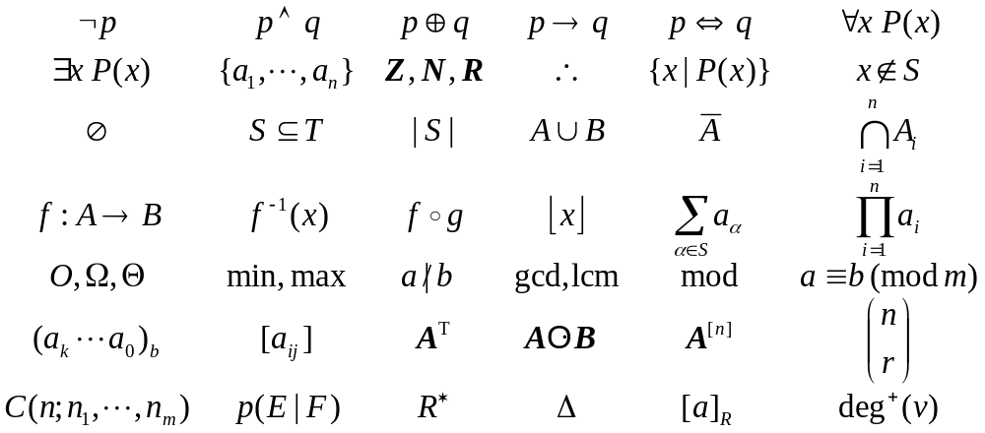
Some Notations We’ll Learn
115/11/07
(c)2001-2003, Michael P. Frank

Slide 10
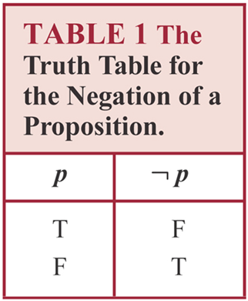
Truth Table for the Negation of a Proposition
The negation of a proposition can also be considered the result of the operation of the negation operator on a proposition. The negation operator constructs a new proposition from a single existing proposition.

Slide 11
Logical Operators
Logical operators that are used to form new propositions from two or more existing propositions are called connectives.
Definition 2
Let p and q be propositions. The conjunction of p and q, denoted by p ∧ q, is the proposition “p and q.” The conjunction p ∧ q is true when both p and q are true and is false otherwise.

Slide 12
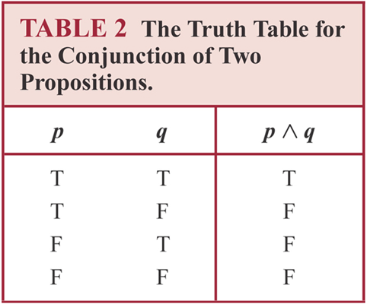
Truth Table for the Conjunction of two Propositions

Slide 13
Example
Find the conjunction of the propositions p and q where p is the proposition “Rebecca’s PC has more than 16 GB free hard disk space” and q is the proposition “The processor in Rebecca’s PC runs faster than 1 GHz.”
Solution
The conjunction of these propositions, p ∧ q, is the proposition “Rebecca’s PC has more than 16 GB free hard disk space, and the processor in Rebecca’s PC runs faster than 1 GHz.” This conjunction can be expressed more simply as “Rebecca’s PC has more than 16 GB free hard disk space, and its processor runs faster than 1 GHz.” For this conjunction to be true, both conditions given must be true. It is false, when one or both of these conditions are false.

Slide 14
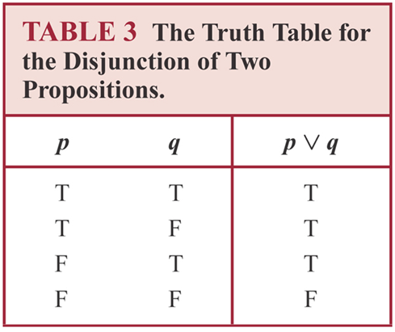
Definition 3
Let p and q be propositions. The disjunction of p and q, denoted by p ∨ q, is the proposition “p or q.” The disjunction p ∨ q is false when both p and q are false and is true otherwise.

Slide 15
Example
What is the disjunction of the propositions p and q where p is the proposition “Rebecca’s PC has more than 16 GB free hard disk space” and q is the proposition “The processor in Rebecca’s PC runs faster than 1 GHz.”?
Solution
The disjunction of p and q, p ∨ q, is the proposition “Rebecca’s PC has at least 16 GB free hard disk space, or the processor in Rebecca’s PC runs faster than 1 GHz.”

Slide 16
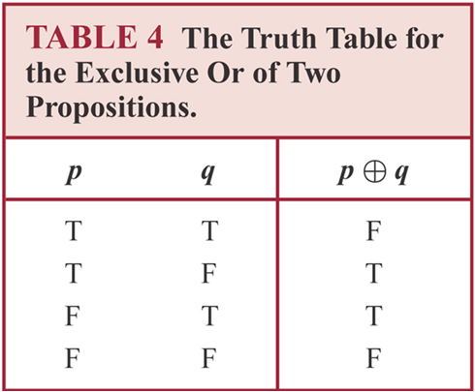
Definition 4
Let p and q be propositions. The exclusive or of p and q, denoted by p ⊕ q, is the proposition that is true when exactly one of p and q is true and is false otherwise.

Slide 17
The Exclusive Or Operator
The binary exclusive-or operator “⊕” (XOR) combines two propositions to form their logical “exclusive or” (exjunction?).
p = “I will earn an A in this course,”
q = “I will drop this course,”
p ⊕ q = “I will either earn an A in this course, or I will drop it (but not both!)”

Slide 18
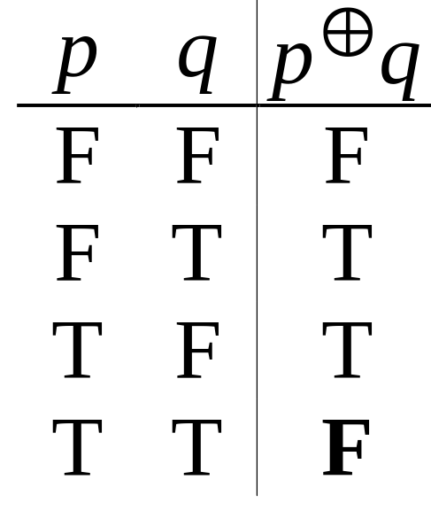
Exclusive-Or Truth Table
Note that p⊕q means
that p is true, or q is
true, but not both!
This operation is
called exclusive or,
because it excludes the
possibility that both p and q are true.
“¬” and “⊕” together are not universal.
Note
difference
from OR.
Notes:
A good way to remember the symbol for XOR, a plus sign inside an O, is to think of XOR as adding the bit-values of its inputs (mod 2). E.g., 0+0=0, 1+0=0, 1+1=0 (mod 2). Thus XOR is basically an addition, and we put it inside an “O” to remind ourselves that it is a type of “Or”.
XOR together with unary operators do not form a universal set of operators over the Booleans. However, it turns out that they are a universal set for quantum logic! However we do not have time to cover quantum computing in this class, interesting though it is.

Slide 19
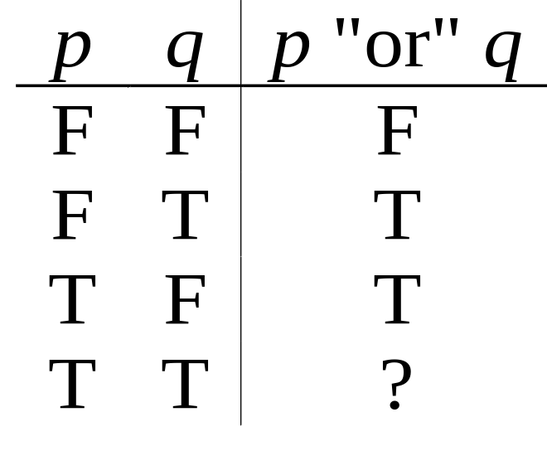
Natural Language is Ambiguous
Topic #1.0 – Propositional Logic: Operators
Note that English “or” can be ambiguous regarding the “both” case!
“Pat is a singer or
Pat is a writer.” -
“Pat is a man or
Pat is a woman.” -
Need context to disambiguate the meaning!
For this class, assume “or” means inclusive.
∨
⊕

Slide 20
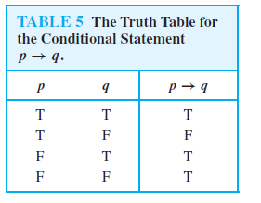
Conditional Statement
Let p and q be propositions. The conditional statement p → q is the proposition “if p, then q.” The conditional statement p → q is false when p is true and q is false, and true otherwise.
In the conditional statement p → q, p is called the hypothesis (or antecedent or premise) and q is called the conclusion (or consequence).
The statement p → q is called a conditional statement because p → q asserts that q is true on the condition that p holds. A conditional statement is also called an implication.

Slide 21
English Phrases Meaning p → q
“p implies q”
“if p, then q”
“if p, q”
“when p, q”
“whenever p, q”
“q if p”
“q when p”
“q whenever p”
“p only if q”
“p is sufficient for q”
“q is necessary for p”
“q follows from p”
“q is implied by p”
We will see some equivalent logic expressions later.

Slide 22
Some Popular Boolean Operators
Formal Name | Nickname | Arity | Symbol
Negation operator | NOT | Unary | ¬
Conjunction operator | AND | Binary | ∧
Disjunction operator | OR | Binary | ∨
Exclusive-OR operator | XOR | Binary | ⊕
Implication operator | IMPLIES | Binary | →
Biconditional operator | IFF | Binary | ↔

Slide 23
CONVERSE, CONTRAPOSITIVE, AND INVERSE
We can form some new conditional statements starting with a conditional statement p → q.
The proposition q → p is called the converse of p → q.
The contrapositive of p → q is the proposition ￢ q → ￢ p.
The proposition ￢ p →￢ q is called the inverse of p → q.
Of these three conditional statements formed from p → q, only the contrapositive always has the same truth value as p → q.

Slide 24
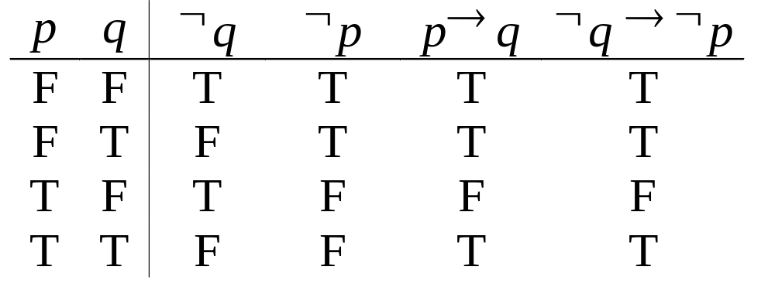
How do we know for sure?
Proving the equivalence of p → q and its contrapositive using truth tables:

Slide 25
Example
What is the value of the variable x after the statement
if 2 + 2 = 4 then x := x + 1
if x = 0 before this statement is encountered? (The symbol := stands for assignment. The statement x := x + 1 means the assignment of the value of x + 1 to x.)
Solution
Because 2 + 2 = 4 is true, the assignment statement x := x + 1 is executed. Hence, x has the value 0 + 1 = 1 after this statement is encountered.

Slide 26
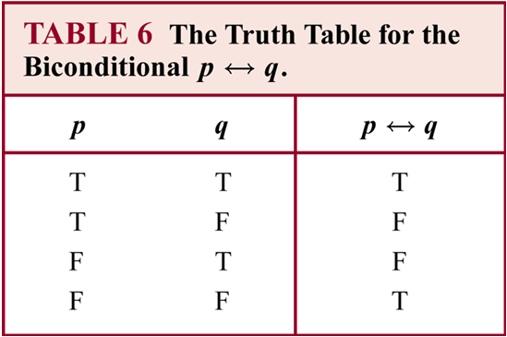
Biconditionals
Let p and q be propositions. The biconditional statement p ↔ q is the proposition “p if and only if q.” The biconditional statement p ↔ q is true when p and q have the same truth values, and is false otherwise. Biconditional statements are also called bi-implications.

Slide 27
Biconditionals-Continue
Note that the statement p ↔ q is true when both the conditional statements p → q and q → p are true and is false otherwise.
That is why we use the words “if and only if” to express this logical connective and why it is symbolically written by combining the symbols → and ←.
There are some other common ways to express p ↔ q:
  “p is necessary and sufficient for q”
  “if p then q, and conversely”
  “p iff q.”
The last way of expressing the biconditional statement p ↔ q uses the abbreviation “iff” for “if and only if.”

Slide 28
Example
Let p be the statement “You can take the flight,” and let q be the statement “You buy a ticket.” Then p ↔ q is the statement “You can take the flight if and only if you buy a ticket.”

Slide 29
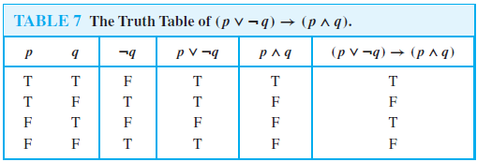
Truth Tables of Compound Propositions
Logical connectives—conjunctions, disjunctions, conditional statements, and biconditional statements, negations.
Construct the truth table of the compound proposition
(p ∨￢ q) → (p ∧ q).

Slide 30
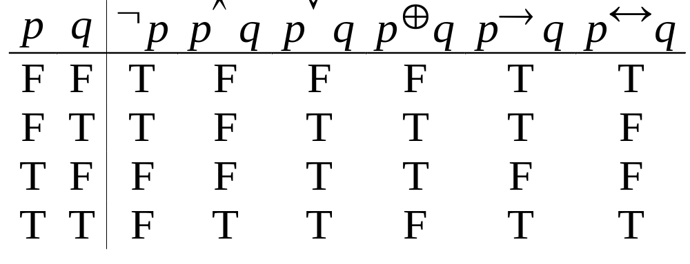
Boolean Operations Summary
We have seen 1 unary operator (out of the 4 possible) and 5 binary operators (out of the 16 possible). Their truth tables are below.
Notes:
For fun, try writing down the truth tables for each of the 4 possible unary operators, and each of the 16 possible binary operators. For each one, try to come up with an English description of the operator that conveys its meaning. Also, figure out a way to define it in terms of other operators we already introduced.

Slide 31
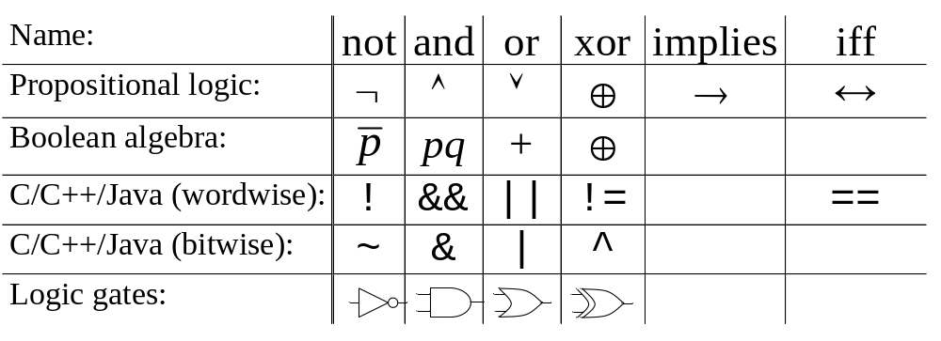
Some Alternative Notations

Slide 32
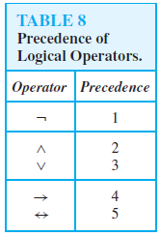
Precedence of Logical Operators

Slide 33
Precedence of Logical Operators
Negation operator is applied before all other logical operators
Conjunction operator takes precedence over disjunction operator
Conditional and biconditional operators have lower precedence
Parentheses are used whenever necessary

Slide 34
Precedence of Logical Operators
(p ∨ q) ∧ (￢ r) is the conjunction of p ∨ q and ￢ r.
To reduce the number of parentheses, we specify that the negation operator is applied before all other logical operators.
This means that ￢p ∧ q is the conjunction of ￢p and q, namely, (￢ p) ∧ q, not the negation of the conjunction of p and q, namely￢(p ∧ q).
Another general rule of precedence is that the conjunction operator takes precedence over the disjunction operator, so that p ∧ q ∨ r means (p ∧ q) ∨ r rather than p ∧ (q ∨ r).
p ∨ q → r is the same as (p ∨ q) → r

Slide 35
Logic and bit operations
Computers represent information using bits. A bit is a symbol with two possible values, namely, 0 (zero) and 1 (one).
A bit can be used to represent a truth value, because there are two truth values, namely, true and false.
As is customarily done, we will use a 1 bit to represent true and a 0 bit to represent false. That is, 1 represents T (true), 0 represents F (false).
A variable is called a Boolean variable if its value is either true or false.
Consequently, a Boolean variable can be represented using a bit.

Slide 36
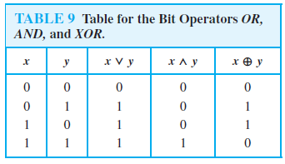
Logic and bit operations
Computer bit operations correspond to the logical connectives. By replacing true by a one and false by a zero in the truth tables for the operators ∧, ∨, and ⊕,

Slide 37
Bit String
A bit string is a sequence of zero or more bits. The length of this string is the number of bits in the string. 101010011 is a bit string of length nine.
We define the bitwise OR, bitwise AND, and bitwise XOR of two strings of the same length to be the strings that have as their bits the OR, AND, and XOR of the corresponding bits in the two strings, respectively.
We use the symbols ∨,∧, and ⊕ to represent the bitwise OR, bitwise AND, and bitwise XOR operations, respectively.

Slide 38
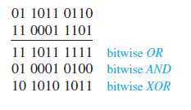
Bit String-Example
Find the bitwise OR, bitwise AND, and bitwise XOR of the bit strings 01 1011 0110 and 11 0001 1101.
Solution
The bitwise OR, bitwise AND, and bitwise XOR of these strings are obtained by taking the OR, AND, and XOR of the corresponding bits, respectively. This gives us

